Slide 1


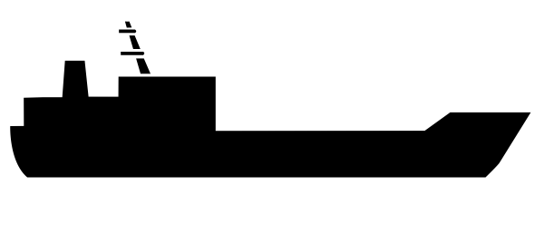









(Non-confidential summary) Supply Chain Flows AOT
UK
Production
Pre-treatment
Argent Energy Ltd. Stanlow, Ellesmere Port, UK
Bulk sales
AOT
(Tank Storage)
Production
Pre-treatment
Argent Energy (UK) Ltd. Motherwell, UK
Truck sales
Mixed Feedstock
1

